Slide 1

NanoJPEG CUDA
Parallelization of a JPEG Decompression Library on a CUDA GPGPU
Lorenzo CHIOLA, s287911

Slide 2
JPEG/JFIF Format
JPEG: Image Compression
choice of color spaces
choice of compression quality
choice of subsampling
JFIF: Container Format
choice of sections (some are mandatory)
progressive JPEG

Slide 3
JPEG Compression Overview
8x8 px blocks
Chroma Subsampling
DCT: Dual Cosine Transform
Huffman Encoding
Separate DC component

Slide 4
JFIF (JPEG File Interchange Format)
SOF (Start Of Frame)
Width, height, color space...
DHT (Define Huffman Table)
Huffman code tree. Y DC, Y AC, Cb/Cr DC, Cb/Cr AC
DQT (Define Quantization Table)
Separate for Y and Cb, Cr
DRI (Define Restart Interval)
DC DPCM restart component
(Start of) Scan
Actual data: 8x8 blocks

Slide 5
JFIF Scan
8x8 Blocks grouped into MCUs (Minimum Coded Units)
RGB: {R, G, B}, {R, G, B}, …
YcbCr 4:4:4: {Y, Cb, Cr}, {Y, Cb, Cr}, …
Chroma Subsampling (less chrominance information)
YcbCr 4:2:2: {Y, Y, Cb, Cr}, {Y, Y, Cb, Cr}, …
YcbCr 4:2:0: {Y, Y, Y, Y, Cb, Cr}, {Y, Y, Y, Y, Cb, Cr}, …
Y
Y
Cb
Cr
Y
Y

Slide 6
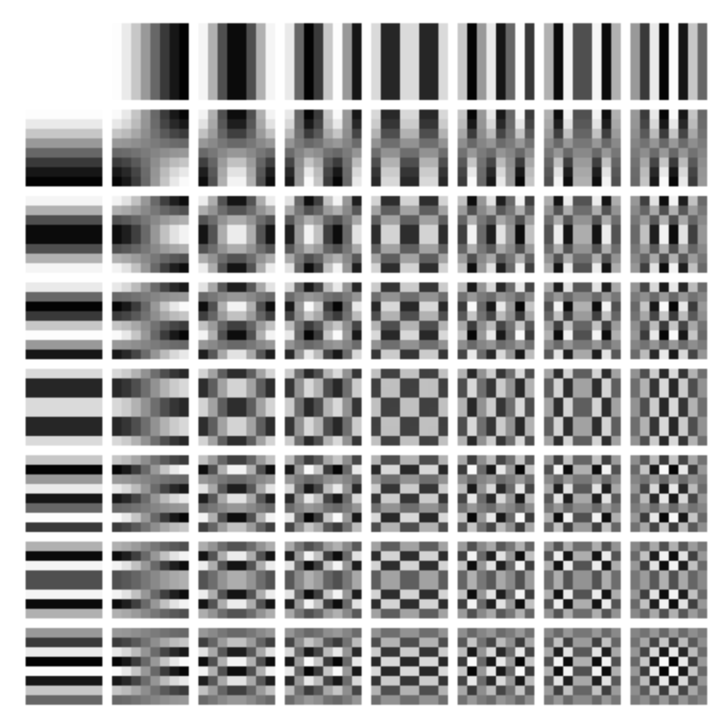
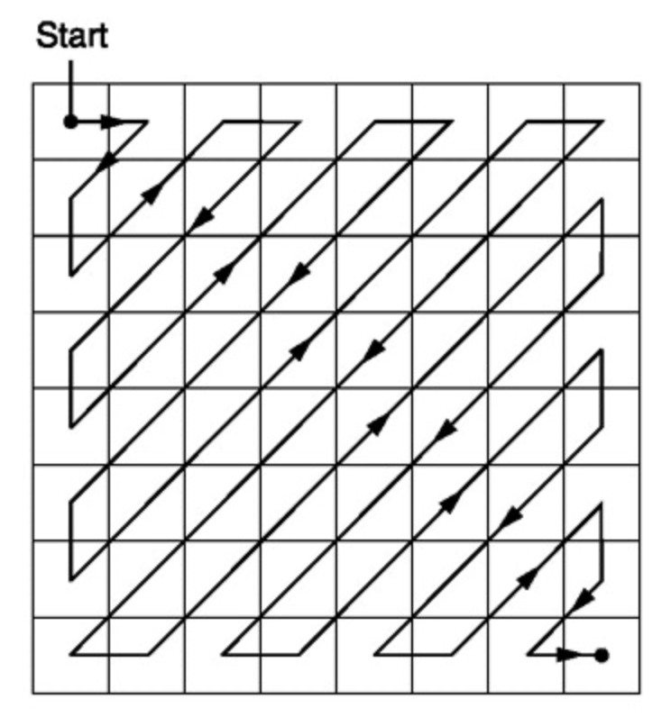
JFIF Scan: Blocks
DC coefficient (zero frequency: cell [0, 0])
Differential Pulse Code Modulation (DPCM)
AC coefficient (the other 63 cells)
Zig-Zag order: from low to high frequency
Huffman encoded

Slide 7
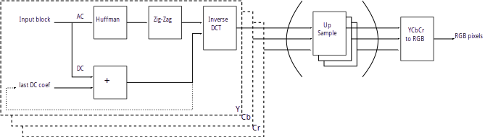
JPEG compression flow

Slide 8
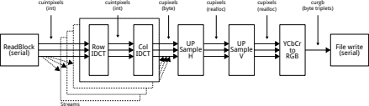
NanoJPEG CUDA Data Flow

Slide 9
Streamed execution
CPU
Four CUDA Streams
Default CUDA Stream
CPU

Slide 10
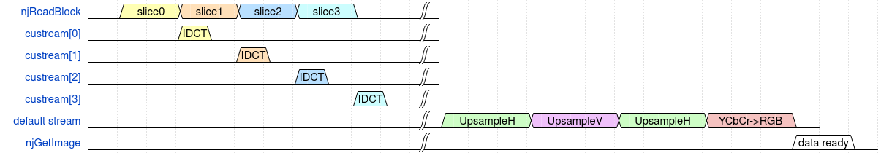
Streamed execution
Few CUDA cores: 1 SM / 128 Threads
Disk I/O bound workload

Slide 11
Inverse Discrete Cosine Transform (IDCT)
0
1
8 pixels, no neighbors
In-place
Horizontal and Vertical are similar
Easy to parallelize
2
3
4
5
0
1
2
3
4
5
6
7
6
7

Slide 12
Upsampling, RGB conversion
Interdependent
pixels
8/16 pixel in per thread
16 pixel out per thread

Slide 13
NanoJPEG CUDA Performance
Advantageous for big images (on Jetson Nano)
1 Megapixel: GPU on par with single-thread CPU
8 Megapixel: GPU 40% faster than single-thread CPU
Pro: elaboration in parallel with disk read
Problems: elaboration is faster than disk I/O
(bottleneck)
Performance must be evaluated
for any particular CPU + GPU + DISK combination

